Slide 1
Social and Creative Entrepreneurial Skills
Professor Richard Hazenberg,
Institute for Social Innovation & Impact,
University of Northampton.

Slide 2
Course Overview
The aim of this course is to provide you with:
Understanding of what constitutes social innovation (SI).
The different models that exist.
Enablers/barriers to social innovation.
How social innovation can be taught/mentored.
Across the three days the main learning points are:
The role of power in shaping social innovation.
The role of social networks in shaping social innovation.
The need for partnerships & collaboration in driving SI.
Social innovation is culturally and socially contextual. This course will not provide you with all of the answers!
That is your job as social innovators and enablers.

Slide 3
Introducing Social Innovation
Part 1 – Seminar 1
Professor Richard Hazenberg,
Institute for Social Innovation & Impact,
University of Northampton.

Slide 4
Overview
In this seminar we will explore:
Definitions of social innovation
Social embeddedness of SI
Role of community engagement in SI
Policy and SI
Funding SI

Slide 5
Defining Social Innovation
Not a singular definition of SI, as it's such a diffuse concept.
SI represents new ways of developing/delivering products/services that deliver social impacts and catalyse change in society (Heiscala, 2007).
It really represents:
Ability of innovators to holistically link stakeholders and use these partnerships to deliver new combinations of resources (financial and otherwise).
Universities can act as the hubs of such partnerships and link different elements of society.

Slide 6
Defining Social Innovation
Represents the growing focus on hybridity in society.
'De-powering' of processes to allow genuine community engagement. Beneficiaries are the experts and should be involved as co-producers.
This support can come in the form of teaching and educational resources to enable social innovation.
Social entrepreneurship is a type of social innovation.

Slide 7
Embeddedness & Social Innovation
Social innovation is a socially embedded construct:
Socially constructed with different meanings across different communities.
Relates to community-led bottom-up social action.
Power is central to enabling social innovation, as this inhibits and/or enables social action.
Power exists in the form of institutions, political power (policy), finance, and social networks

Slide 8
Embeddedness & Social Innovation
The embedded nature of social innovation allows powerful actors to shape discourse:
Use their access to capitals (economic, social, intellectual, political, human etc.) to develop dominant narratives.
Social innovators can overcome this discourse and reshape societal structures to create value.
This makes empowerment of those without traditional access to resource central to social innovation:
Universities are crucial in providing this support/empowerment.

Slide 9
Role of Community Engagement in Social Innovation
Community engagement is central to driving the bottom-up social innovation that we have discussed.
However, this can be difficult to achieve as:
Some communities are hard to reach due to:
Disadvantage
Geography
Socio-economic factors
Willingness to engage
However, social innovation involves the restructuring of society, so community voices are essential to this process.

Slide 10
Role of Community Engagement in Social Innovation
So how do we engage with beneficiaries/communities?
Institutional democratic decision-making processes:
Beneficiaries engaged at Board level.
Cooperative style membership structures (1 member = 1 vote)
Public forums for policy/practice
Critical reflection encouraged in all stakeholders
Creativity in shaping new ideas is also key here.
It is also about ensuring that all citizens are encouraged to be ‘Changemakers’ in society:
Inspiring, mentoring and collaborating with other citizens.

Slide 11
Policy & Social Innovation
Policy can also be a powerful enabler/inhibitor of SI.
Policy-makers can through their actions create ‘policy-windows’ for social action.
Political, socio-economic, institutional factors within this.
Essentially policy-windows can empower social innovators.
Role of social entrepreneurs within this process is critical.
Partnerships and collaborations are also key.

Slide 12
Policy & Social Innovation
Policy is therefore only an initial enabler, embedded within wider exogenous factors:
Recessions, globalisation and social/cultural factors.
A major factor in this wider ecosystem is funding:
Economic capital is a strong form of power enabler.
Funding and investment are therefore another important enabler of social innovation.

Slide 13
Funding & Social Innovation
Funding for social innovation can come in many forms:
Social investment
Public funding
Philanthropic funding
Private investment
Community bootstrapping
Disadvantaged communities rarely have access to significant financial capital.
Therefore, finance can be a key inhibitor of social innovation.

Slide 14
Summary
Social innovation is a diffuse concept that takes many forms:
Multiple models of social innovation.
Universities can play a central role in driving social innovation.
Different actors/institutions can lead social innovation.
Partnerships and collaborations are important.
Policy and funding is critical to scaling SI ecosystems.
Social networks and embeddedness key to empowering SI.
Enabling bottom-up creativity critical to social innovation.
These are all areas that we will explore over the next 3 days.

Slide 16
Models of Social Innovation
Part 1 – Seminar 2
Professor Richard Hazenberg,
Institute for Social Innovation & Impact,
University of Northampton.

Slide 17
Overview
In this seminar we will explore:
Models of social innovation
State-led SI (policy frameworks)
SI in public service delivery
Charities, NPOs and Voluntary Orgs
Social enterprise/entrepreneurship
Social investment

Slide 18
Models of Social Innovation
It is important to recognise that models of social innovation come in numerous forms:
Social entrepreneurship
Social intrapreneurship
Policy innovation
Public service innovation
Citizen innovation
Financial innovation
This is not a hierarchical list, and often the most successful social innovations combine several of these types.

Slide 19
State-led SI
The state can be a powerful driver of SI, as it can exercise power through funding and policy.
Policy frameworks can shape the behaviour of the ecosystem:
Establishes normative ideas/behaviour through the creation of a dominant discourse.
Controls the flow of resources through the ecosystem (financial and non-financial).
Can fundamentally alter the ecosystem by shaping networks and communication.

Slide 20
SI in Public Services
Policy can also shape public service delivery, which can drive social innovation:
Social Enterprise Investment Fund in the UK:
£110m of funding for health and social care ‘spin-outs’ from UK public services.
These spin-outs involve staff leading a service out of the public sector and turning it into a social enterprise.
Turned the health and social care sector into one of the largest in the UK social enterprise ecosystem.
UK Public Services (Social Value) Act 2012:
Requires all UK public bodies to ‘consider’ social value when commissioning services.
Has led to social value clauses in contracts (not just in public bodies).
University of Northampton now utilises social value contracts.

Slide 21
Third Sector & SI
This is the traditional sector associated with SI:
Charities, voluntary organisations, and Foundations.
Social innovation in this sector has traditionally been bottom-up led through communities:
However, a greater focus on hybridity and marketisation is changing this.
This is another area being shaped by policy frameworks and dominant discourse……in other words, power.
In the UK we are seeing a drive towards making the third sector more business-like.
Charities are therefore establishing social enterprises and seeking investment.

Slide 22
Social Entrepreneurship
Social entrepreneurship ”…encompasses the activities and processes undertaken to discover, define and exploit opportunities in order to enhance social wealth by creating new ventures or managing existing organisations in an innovative manner” (Zahra et al., 2009:519).
Social enterprises seek to use markets to reduce social inequality and improve people’s access to opportunities (Nicholls, 2007).
Crucial to understand the difference between the two:
Social entrepreneurship is a form of individual/collective behaviour.
Social enterprise is a type of organisational form for achieving this.

Slide 23
Social Entrepreneurship
Social entrepreneurship is at the heart of social innovation, as both seek to:
Enhance collective wealth/power resources.
Challenge normative structures (power, resource, discourse).
Social entrepreneurs can exist in:
Private sector, public sector, third sector and civil society.
They are the Changemakers that drive social innovation.
They can exist in Universities as well…you can be a social entrepreneur!

Slide 24
Social Investment
Resources are also key in driving social innovation:
Investment can form a key part of this, and social investment has grown over the last decade to provide this.
Social investment can be defined as the provision of finance to social ventures (either debt or equity finance), with an expectation that a social as well as financial return will be generated (Brown and Norman, 2011).
However, despite the growth in social investment, there remains a lack of innovation in the investment products developed.

Slide 25
Social Investment
Innovative funding solutions for socially innovative projects are essential to scaling SI ecosystems.
In the UK examples include:
Social Impact Bonds.
Hybrid social investment products (debt and equity).
In Vietnam, also innovation through non-financial repayment:
Thriive ask for loans to be repaid through product/service provision.

Slide 26
SI/SE Ecosystem
Social innovation ecosystems are therefore heterogeneous:
Include multiple models
Diverse stakeholder networks/types
Multiple relationship types & resource flows
Dominant actors can use their power and resources to shape discourse and normalise their visions of social innovation.
Partnerships and collaborations between non-dominant stakeholders can overcome this.
Universities can support this pluralism.

Slide 27
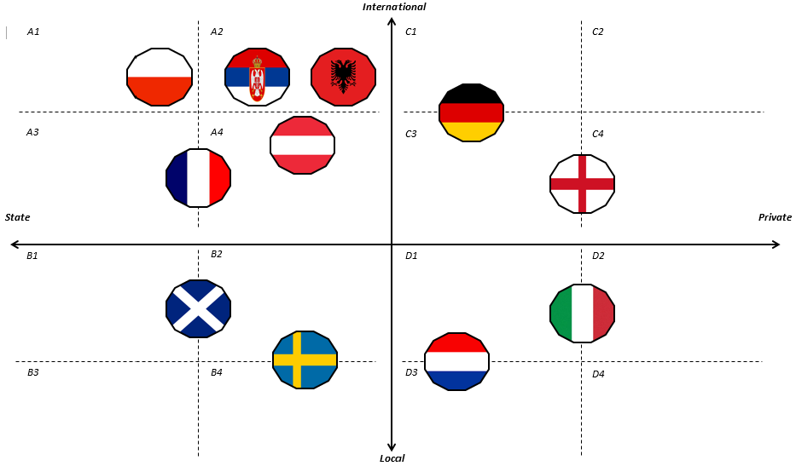

Slide 29
Pedagogy of Social Innovation
Part 1 – Seminar 3
Professor Richard Hazenberg,
Institute for Social Innovation & Impact,
University of Northampton.

Slide 30
Overview
In this seminar we will explore:
Skills of social innovators
Practical support
Beneficiary/social value focus

Slide 31
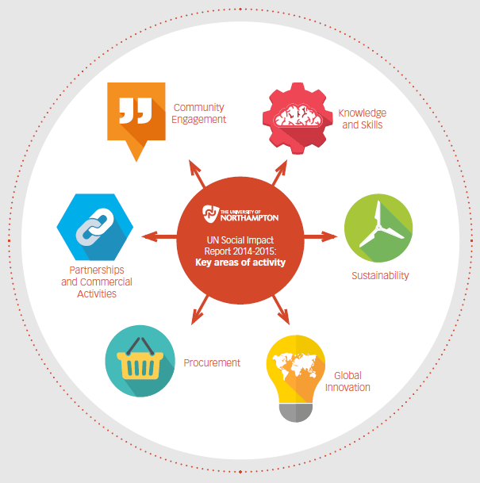
Universities & SI

Slide 32
Skills of Social Innovators
In developing social innovators universities are encouraging:
employability;
creativity;
self-efficacy;
and ensuring that they are socially aware and that they can become Changemakers.
This enables them to think laterally and approach societal problems from new perspectives (e.g. UoN hospital choir).
Creating the global citizens of tomorrow, who can think idealistically, but engage in the realities of the world.
universities

Slide 33
Practical Support
It is also crucial that the teaching of social innovation involves learning by doing.
Social innovators are encouraged to apply their learning in practical settings.
That mistakes are encouraged, as we learn more from these than we do from successes.
That practical learning is brought back to the classroom for reflection (nexus of theory of practice).
Universities can also support social innovators to navigate barriers:
Overcoming power and resource deficiencies.
Universities are powerful institutions with significant resources (financial, intellectual, human, social).

Slide 34
Social Value Focus
Ensure that you are engaged with your local communities:
What are their social problems/priorities?
In what areas do they want to see social innovation?
How can universities support them to achieve these?
Communities and social innovators are the experts:
We are there to support them with our knowledge and skills.
We can use our power and networks, to drive collaborations and support social innovators to develop social value.

Slide 35
Summary
The 5 key areas for driving SI in HEIs are:
Defining what social innovation means to your institution.
Applying this flexibly.
Becoming genuine community hubs.
De-powering processes.
Embedding SI effectively in the curriculum, through academic, policy and practical methods.
Empowering students to become creative Changemakers.
Investing in SI strategically across the institution:
Multiple resources.
Measuring your impact.
Maintaining momentum through leadership.

Slide 36
Day 1 ACTIVITY
Work in groups to develop a social innovation idea based upon your roles/expertise. Consider:
What is the aim/mission of your SI?
How will you deliver this?
Organisational structure
Funding
Networks
What barriers will you face?
How can learning/universities support this idea?
How will you engage the community?
How do you encourage creativity?

