Slide 1
Leading Social Innovation
Part 2 – Seminar 1
Professor Richard Hazenberg,
Institute for Social Innovation & Impact,
University of Northampton.

Slide 2
Overview
In this seminar we will explore:
Theories of leadership in SI
How leaders drive/facilitate change through SI.
Leaders (and teachers) as enablers of SI.
Managing SI processes.

Slide 3
Defining Leadership
To motivate followers to achieve at their highest possible level in order to contribute to the accomplishment of their organisation’s goals (Vroom & Jago, 2007)
This ability to motivate people is even more crucial in SI where organisations have to balance financial, social and environmental goals.
Good leaders have the ability to:
Empower others.
Utilise social networks and effective partnerships.
Intrinsically motivate people.

Slide 4
Leadership Skills
Effective leaders in social innovation will be:
Compassionate
Socially connected
Persuasive
Rational risk-takers
Empathetic
Creative
(Leadbeater, 1997; Spinoza et al., 1997; Kopec, 2014)
Crucially, they are also prepared to empower others.

Slide 5
Transformational Leaders
SI leaders can also be considered as transformational leaders.
Transformational leaders engage followers by appealing to their higher needs, so that followers become leaders themselves (Burns, 1978).
This is a key form of empowerment that can facilitate bottom-up social innovation.
Move away from the ideas of ‘heroic’ social entrepreneurs (Seddon et al., 2014).

Slide 6
Transformational Leaders
4 key dimensions of transformational leadership:
idealised influence: strategic vision of the leader & ability to gain trust.
inspirational motivation: effective communication with staff, beneficiaries and external stakeholders.
intellectual stimulation: cognitive/strategic decision-making in developing ideas and driving change.
individualised consideration: empathy with staff, beneficiaries and external stakeholders.
(Bass and Riggio, 2006).
These are key skillsets in facilitating social innovation.

Slide 7
Facilitating Social Innovation
Leaders who facilitate social innovation do so by:
Acting as strategic thinkers to drive top-down social innovation (Vidal, 2005; Tichy and Devanna, 1986).
Motivating individuals to:
Gain their commitment to the organisation (Lowe et al., 1996).
View their work as having a higher meaning (Bono and Judge, 2003).
To gain their emotional buy-in to the mission (Ilies et al., 2006).
In empowering others, the leader creates an environment conducive to bottom-up social innovation.
This is essential when operating dual missions.

Slide 8
Managing SI Processes
The management of social innovation is complex:
Involves competing organisational missions.
Motivating staff without just extrinsic reward.
Strategic thinking and tactical management.
Engagement of diverse stakeholder groups.
Ability to empower others and relinquish control.
It is more than just transactional process management:
It is about being a charismatic and transformational leader (Weber, 1947; Burns, 1978).
Challenging orthodox structures and processes.
Being a Changemaker!

Slide 9
Enabling Social Innovation
In order to enable SI, we need to create ecosystems that are conducive to supporting it through: finance, policy, intellectual capital, networks, and power.
Universities are perfectly placed to foster SI as we can provide support to nascent social innovators in:
Developing strategic visions.
Management of SI processes.
Intellectual stimulation and creative thinking.
Networking and partnerships.
Access to resources.
Overcoming power imbalances.

Slide 10
Summary
Leadership of social innovation is therefore complex.
Requires individuals who can intellectually drive top-down social innovation, whilst also empowering/ motivating bottom-up social innovation.
Universities can play a key role in supporting social innovators to develop these skillsets.
These social innovators can then go into the community to act as teachers themselves.

Slide 12
Partnerships & Collaboration
Part 2 – Seminar 2
Professor Richard Hazenberg,
Institute for Social Innovation & Impact,
University of Northampton.

Slide 13
Overview
In this seminar we will explore:
Understanding the role of networks in SI ecosystems.
How do funders/policy-makers enable networked SI?
How informal collaborations and formal partnerships shape SI?
Role of co-design/delivery in SI.

Slide 14
The Role of Networks
As we explored yesterday, networks are important for the flow of resources (financial and non-financial).
Power within networks shapes this flow of resources.
Partnerships and collaborations can be important in:
Overcoming barriers and power deficiencies.
Accessing resources that you do not have.
Therefore, the network social capital of a social innovator is critical to their success.
Universities can support SIs to broaden their networks and establish new partnerships and collaborations.

Slide 15
Power & Networks
Funders and policy-makers have the ability to shape networks and hence ecosystems, through their financial and political power.
Funders do this through a variety of means including:
Competitive tenders & prescriptive funding regimes.
Contracts and Key Performance Indicators (KPIs).
Financial penalties for non-compliance/poor performance.
Policy-makers also shape ecosystems through their:
Access to financial resources (as with funders above).
Ability to create dominant discourse through policy.
Use of legislation to force compliance.

Slide 16
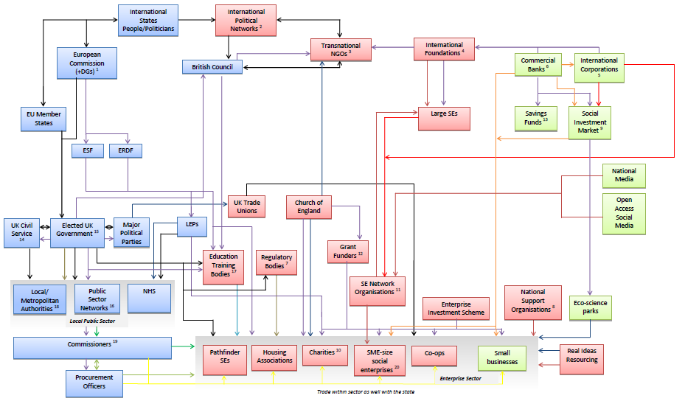

Slide 17
Partnerships & Collaborations
A partnership is a non-hierarchical relationship (at least formally) that involves:
common ownership over problems
commitment to improve the efficiency of the organisations involved
(Coulter, 1999; Gallant et al., 2002).
Collaboration is “what we do” (the verb) when we engage successfully in a ‘partnership’ (the noun) (“what we are”) (Carnwell and Carson, 2008).
The two terms are often used interchangeably, but both involve respect for traits of trust and respect for partners, joint working and teamwork (Carnwell and Carson, 2008).

Slide 18
Partnerships & Collaborations
Partnerships generally occur in two forms:
Formal, where a legal status binds the involved parties to agreed actions and outcomes (Rose, 1994).
Informal, based on informal mutual agreements (Domberger et al., 1997).
Cross-sector partnerships are increasingly common in dealing with complex social problems (Lober, 1997).
Partnerships with service-users/beneficiaries can also provide a means of driving bottom-up social innovation (Hazenberg and Hall, 2016).

Slide 19
Benefits of Partnerships
Partnerships can bring positive impacts:
cost-reductions through greater efficiency (McQuaid, 2000; Savas, 2000)
added value through the joint enhancement of products/services (Steijn et al., 2011)
greater innovation through shared skills and expertise (Parker and Vaidia, 2001; Huxham and Vangen, 2005)
Organisational flexibility during times of policy/fiscal flux (Domberger et al., 1997).
Partnerships and multi-stakeholder collaboration are therefore crucial to social innovation, as multiple resources/skillsets can be utilised to solve social problems.

Slide 20
Partnership Disadvantages
Partnerships can also bring negative impacts:
Difficulties in balancing organisational independence with inter-organisational inter-dependence (Weiner et al., 2000).
Reluctance of organisations to share strategic information with partners, which can damage the formation of trust and cooperation (Domberger et al., 1997).
Informal power imbalances i.e. whilst the partners should be equal, one partner is de facto dominant.
Partnerships and collaborations are not a ‘cure-all’ for solving social problems, as when inappropriate they can be disastrous for organisations.
Have to be used appropriately where needed.

Slide 21
Co-design & Co-delivery
Co-design/co-delivery can be a key element of social innovation strategies, particularly when engaging the community (service-users/beneficiaries).
Co-design involves the use of service-users/beneficiaries in the design of social innovations (i.e. new services).
Increases beneficiary skills
Strengthens communities.
Encourages bottom-up community led interventions.
Provides unique insights into social problems/phenomena.
(Flinders et al., 2015)
Therefore a key form of empowerment & collaboration.

Slide 22
Co-design & Co-delivery
Universities can act as hubs for this type of community engagement, providing links between social innovators and beneficiaries.
Also, empower social innovators that emerge out of socially disadvantaged communities.
Universities can also utilise co-production in research, through the use of co-researchers (Needham et al., 2017)
This can support social innovation creation processes through bottom-up evidence gathering.
Increases democratic accountability to communities.

Slide 23
Summary
Networks are crucial to the flow of resources in social innovation ecosystems.
Power disparities distort the equitable flow of these resources.
Partnerships and collaborations can overcome these barriers and provide access to resources.
Co-production and co-design/delivery with beneficiaries is a key element of this.
Universities can play a key role in supporting the creation of partnerships, in building networks and in using co-production in research.

Slide 25
Policy & Impact of Social Innovation
Part 2 – Seminar 3
Professor Richard Hazenberg,
Institute for Social Innovation & Impact,
University of Northampton.

Slide 26
Overview
In this seminar we will explore:
Understanding social impact measurement (SIM):
Range of tools available
Role in organisational development & SI

Slide 27
Defining Social Impact Measurement
no single universally accepted definition (Sairinen and Kumpulainen, 2005).
SI measurement can be defined as:
“The measurement of the impact of changes (outcomes) intentionally achieved in the lives of beneficiaries as a result of services and products, delivered by an organisation, for which the beneficiary does not give full economic value”
(Clifford et al., 2014)
Effectively measuring the ‘good stuff’ that we are doing.
Over and above mere economic transactions.
Social/environmental focus.

Slide 28
So Why Measure Social Impact?
Provides evidence of the impact that you are having.
Good evidence for stakeholders, funders & beneficiaries.
Allows for organisational learning.
Are you always having a positive impact?
Can help secure contracts/investment. In the UK (NCVO, 2016):
81% VCSEs earned through competitive contract delivery (49% in 2000/01).
Transition in third sector relationship with the state/NGOs/investors:
Desire for evidenced-based policy-making.
Austerity & scarce resources.

Slide 29
GECES Sub-committee on Social Impact Measurement

Slide 30
GECES 5 Stages of SIM
Identify objectives: What are the objectives of the impact measurement (i.e. organisation and partners)?
Identify stakeholders: Who are the beneficiaries and who provide resources?
Relevant measurement: Understand the theory of change and then utilise relevant indicators to capture this.
Measure, validate and value: Assess whether outcomes are achieved and whether they are relevant/recognised by the various stakeholders.
Report, learn and improve: Ensure the dissemination of and meaningful use of the data gathered and findings produced to internal and external stakeholders/audiences.

Slide 31
GECES
In addition, it also recommended the inclusion of:
Deadweight: What changes would have happened anyway, regardless of the intervention?
Alternative attribution: Deducting the effect achieved by the contribution of others (i.e. partner organisations).
Drop-off: Allowing for the decreasing effect of an intervention over time.

Slide 32
Choosing an approach?
There is no right or wrong answer…
3 main influencing factors are:
Motivation
Why are you engaging in SI measurement?
What do you want to get out of it?
What impact do you want it to have?
Readiness
How soon can you engage in SI measurement?
Capacity
Staff expertise & time.
Financial resources.
External contacts/networks.

Slide 33
Which Social Impact Method or Tool?
Eco Management & Audit Scheme (EMAS)
Local Multiplier 3 (LM3)
Prove it!
The Social Impact Measurement for local Economies (SIMPLE)
Social Accounting and Audit (SAA)
Social Return on Investment (SROI)
Volunteering Impact Assessment Toolkit
Social Impact Matrix.
Customer Service Excellence (previously Charter-mark)
European Foundation for Quality Management (EQFM)
Fit for Purpose
Practical Quality Assurance System fr Small Organisations (PQASSO)
Social Enterprise Balanced Scorecard
3rd Sector Performance Dashboard
Quality First
Outcomes Star
SOUL Record

Slide 34
Measuring Social Impact
McLoughlin et al. (2009) developed the SIMPLE methodology that seeks to measure:
Outputs: Direct and easily identifiable
(i.e. jobs created).
Outcomes: Individual beneficiary benefits
(i.e. increased confidence).
Impact: Wider benefit to society (i.e. reduced social security payments).
We combined this approach with an examination of the triple bottom-line to create the ‘Social Impact Matrix’.

Slide 35
Examples in Practice
For example, in a labour market integration social enterprise one of the economic benefits would be employment. This would have:
Output: No. of jobs created.
Outcome: Psychological benefits of
employment (i.e. increased confidence).
Impact: Reduced job-seekers allowance
payments.

Slide 36
Summary
There is no perfect measure of SI measurement.
Organisations need to find the approach that works best for them and aligns with their strategic aims.
The key messages are to:
Understand your theory of change.
When measuring SI understand the:
Why?
How?
Who for?
Ensure that your approach is culturally relevant to the region that you are working in.

Slide 37
Day 2 ACTIVITY
Building on your SI idea developed in Day 1, refine this in relation to the day’s topics:
What would be the role of leadership in your SI?
How could partners be engaged to further this?
What policy mechanisms exist to support it?
How would you measure the social impact of the SI?

